Slide 1
Joint Factor Analysis

Slide 2
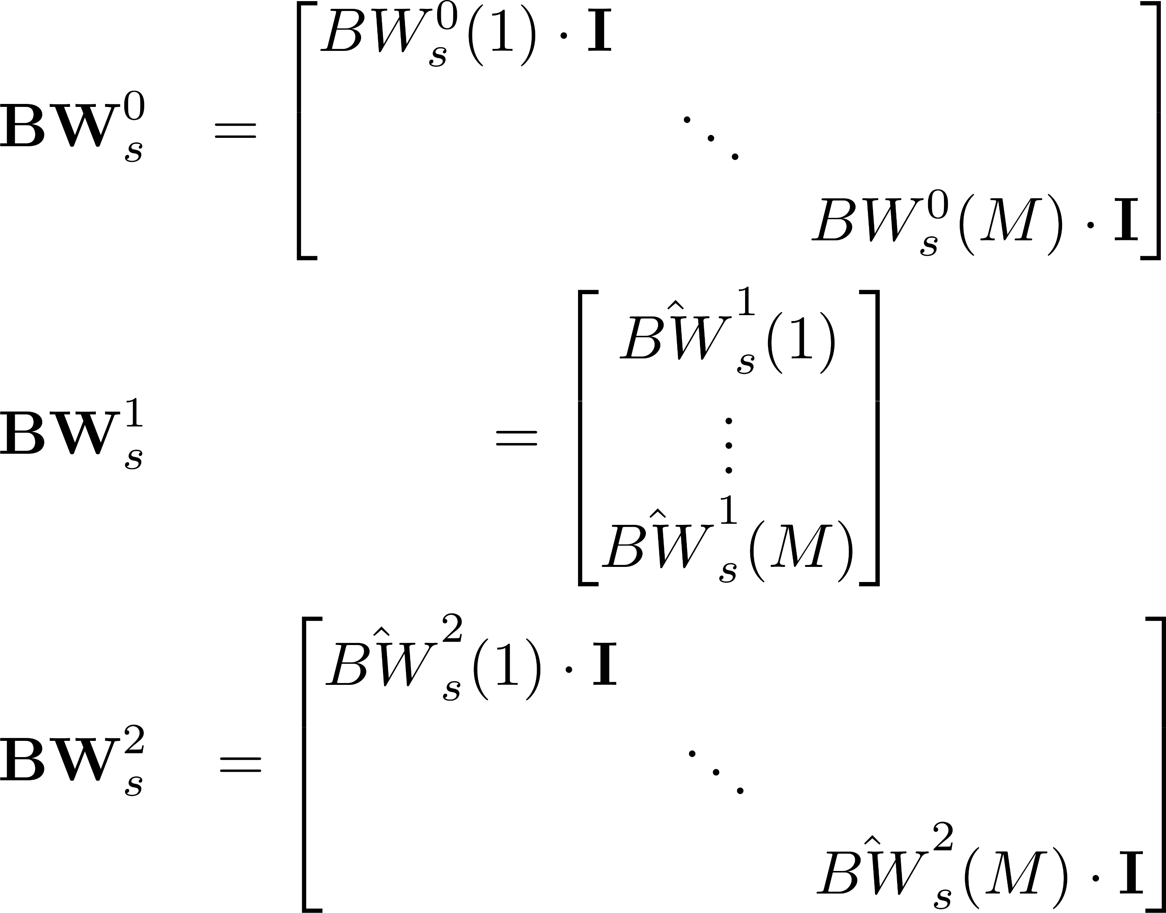
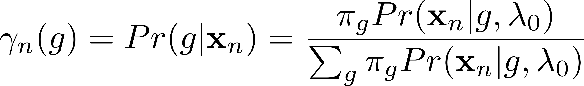
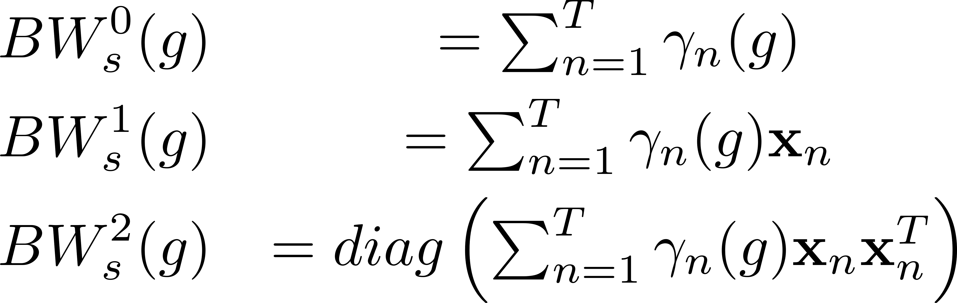
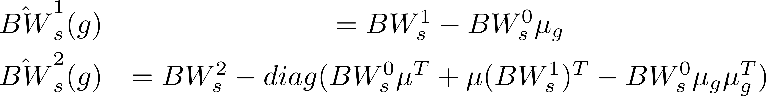
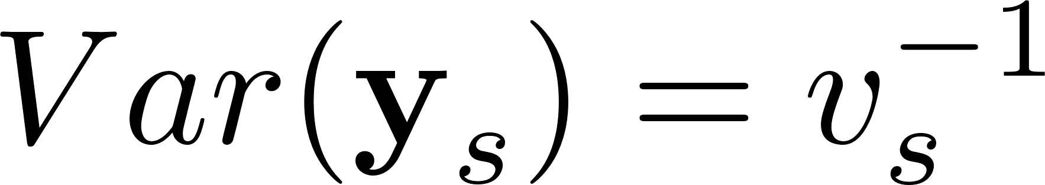
Train the V matrix
Step 3 – Expand the Statistic to Matrices
Step 1 – Compute Sufficient Stats
Step 2 – Center the 1st and 2nd Statistics
Step 3 – Estimate the speaker factor ys

Slide 3
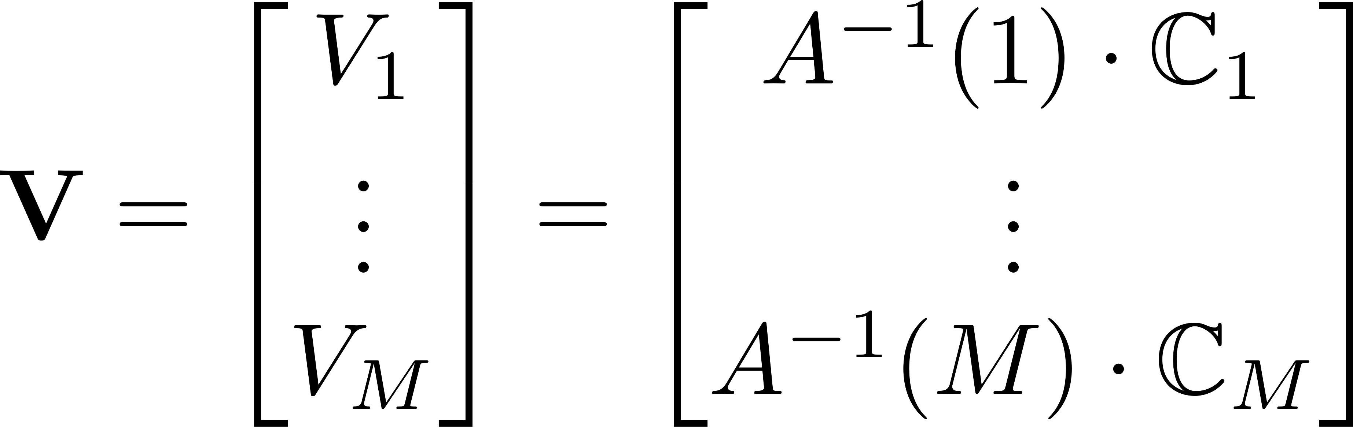
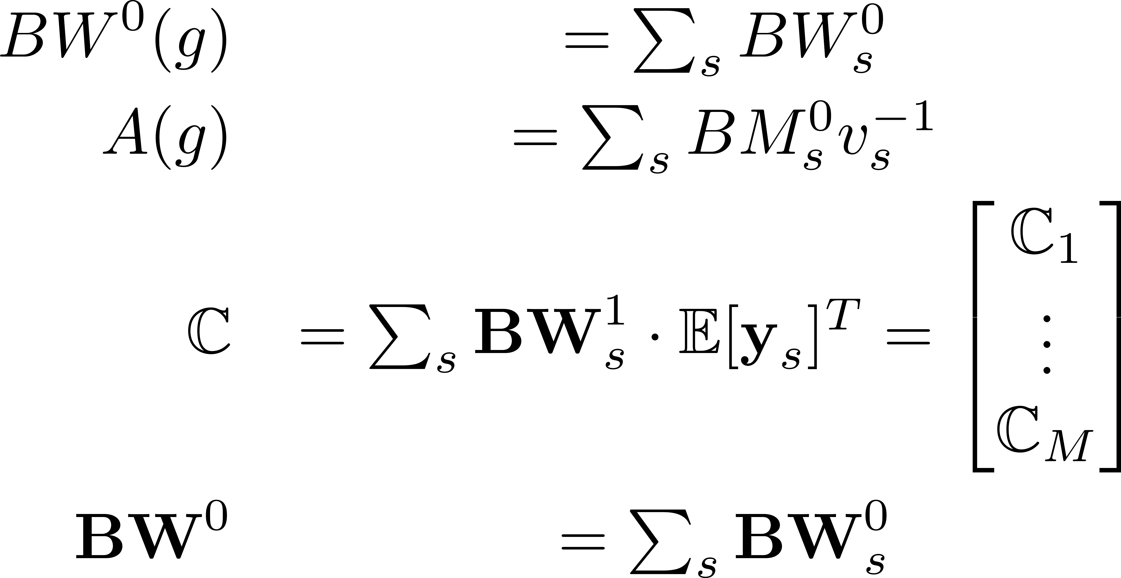
Train the V matrix
Step 5 – Compute the Statistics across Speakers
Step 6 – Estimate V

Slide 4
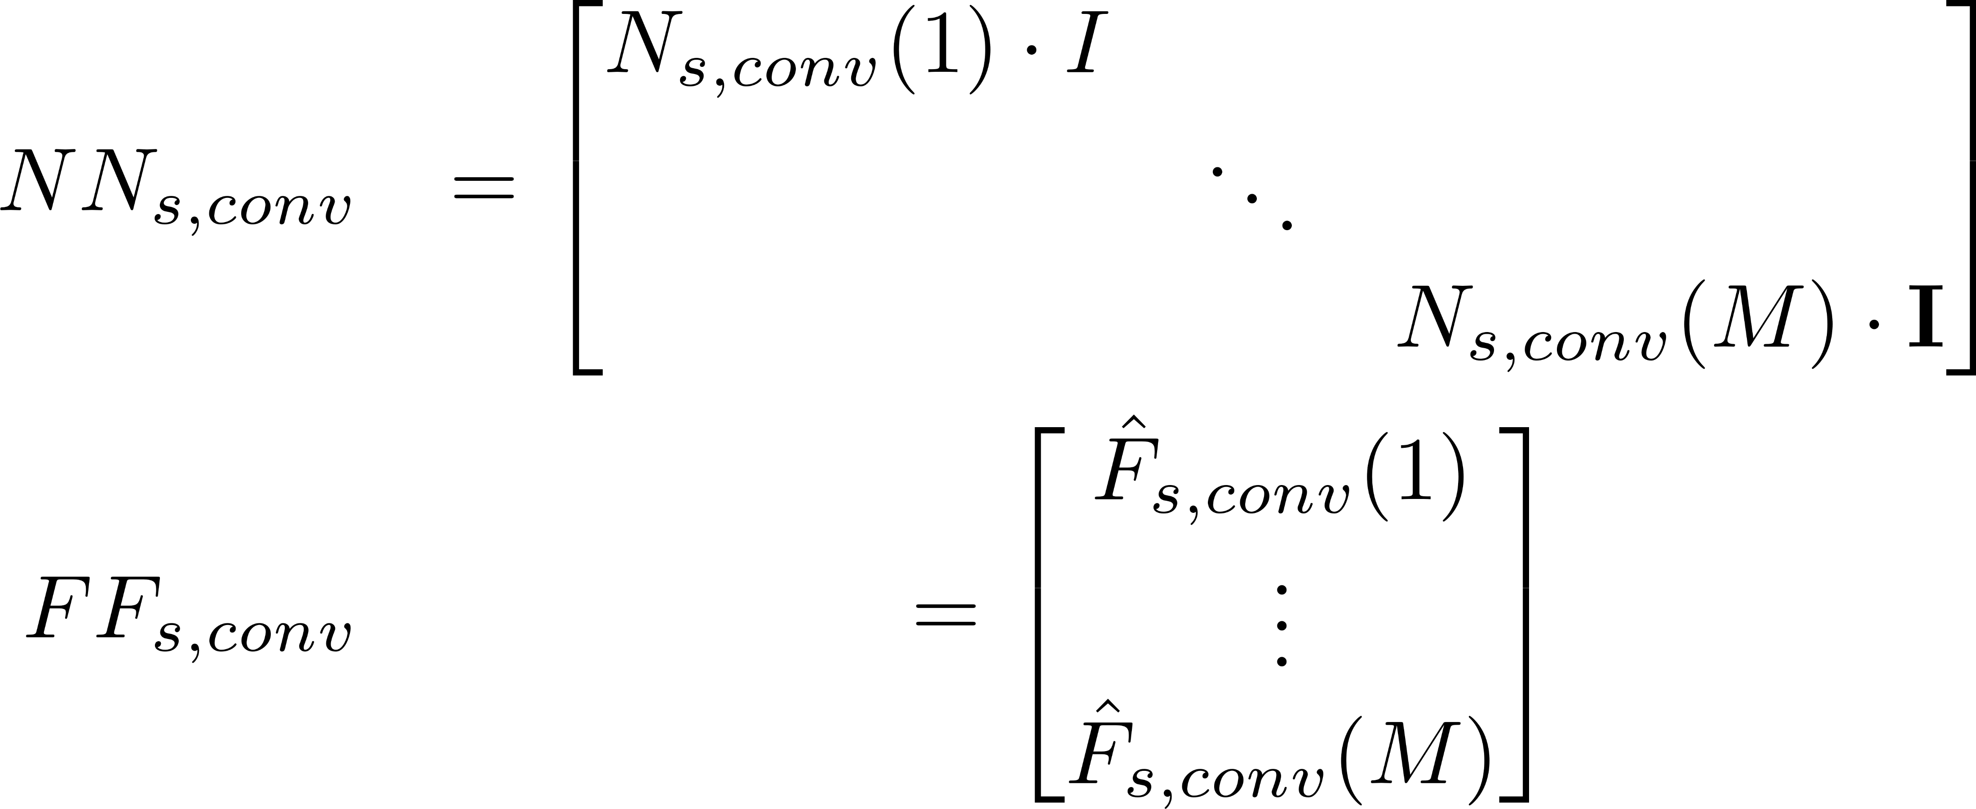
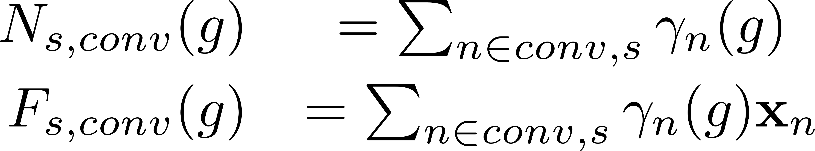
Train the U matrix
Step 1 – Compute 0th and 1st Sufficient Stats
Step 4 – Expand the statistics to matrices
Step 2 – Compute a speaker shift
Step 3 – Compute a shifted version of 1st order statistic with a Gaussian Posterior weighting
Step 5 – Use the same methods as V and y_{s} to train U and c_{h}

Slide 5
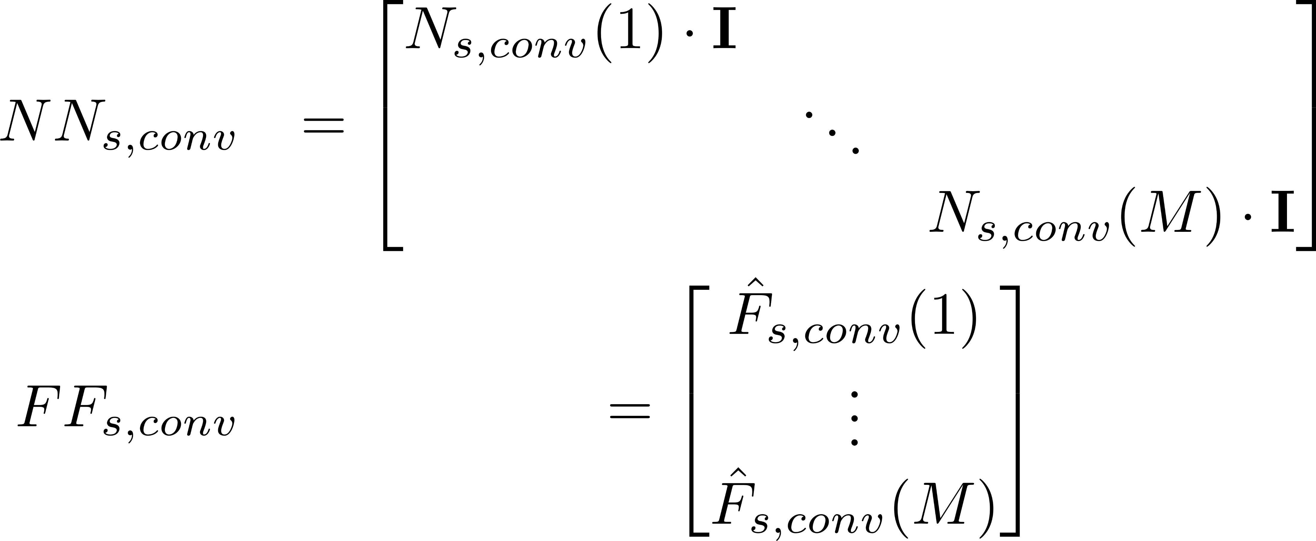
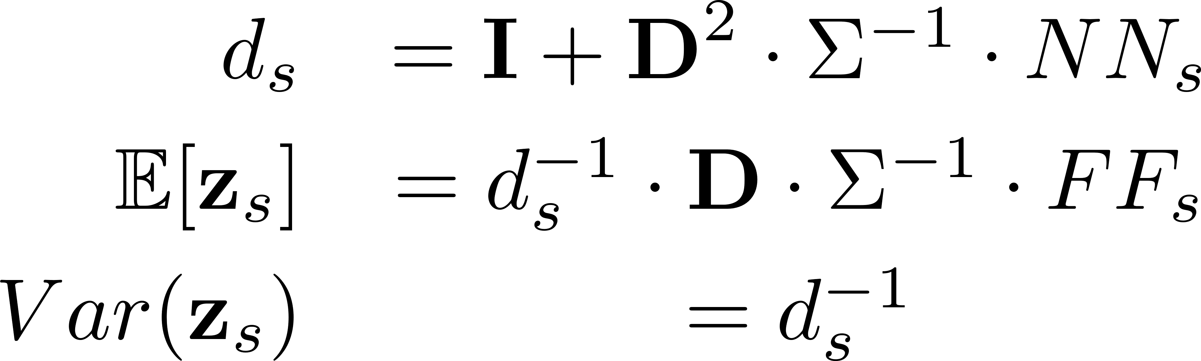
Training the D Matrix
Step 4 – Expand the statistics to matrices
Step 1 – Compute a speaker shift over the s speaker
Step 2 – Compute a channel shift over the s speaker
Step 3 – Subtract the Gauss. Posterior weighing speaker shift and channel shifts from 1st order stat
Step 5 – Estimate the residual factors z

Slide 6
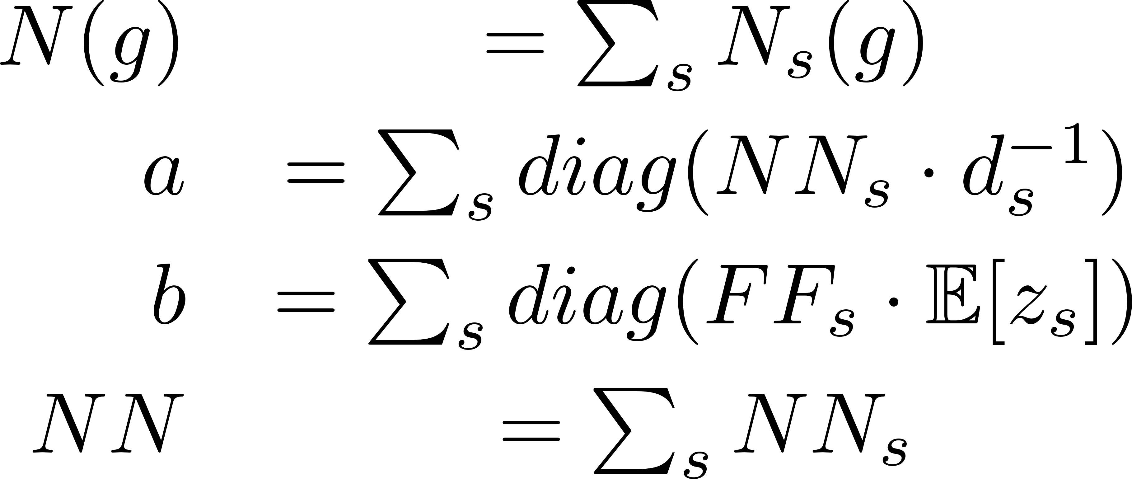
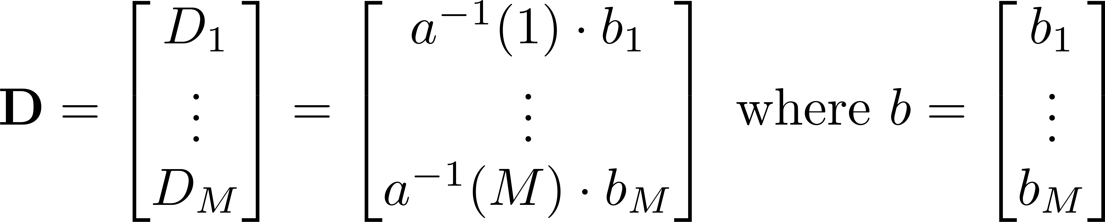
Training the D Matrix
Step 6 – Obtain the statistics across the speakers
Step 8 – Iterate 5-7
Step 7 – Compute the D estimate

